Slide 1
MATH 353
PROBABILITY AND STATISTICS
UNIT 3
Alexander Boateng, PhD
Department of Statistics and Actuarial Science, KNUST

Slide 2
UNIT 3: OUTLINE
Introduction to Random Variables
Discrete Random Variables
Mean and Variance of Discrete R.V.
Continuous Random Variables
Mean and Variance of Continuous R.V.
Cumulative Distribution Functions

Slide 3
UNIT OBJECTIVES:
After completing this unit, you should be able to:
Identify random variables (Discrete and Continuous)
Explain probability distributions (Discrete and Continuous)
Estimate probabilities using probability distribution (Discrete and Continuous)
Explain cumulative distribution functions (Discrete and Continuous)
Calculate the mean, variance and standard deviation (Discrete and Continuous)

Slide 4
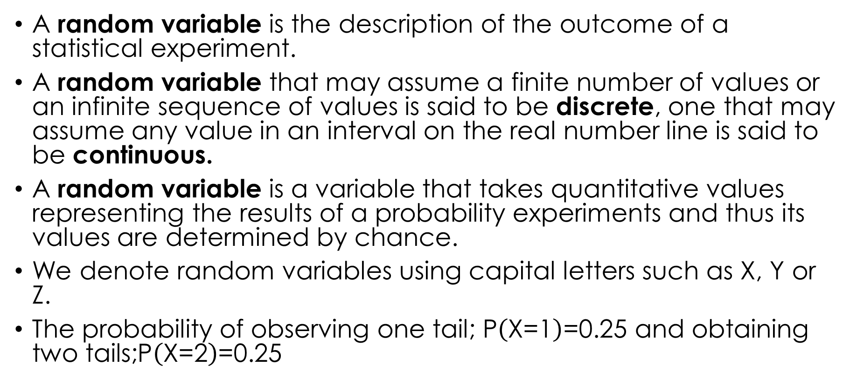
INTRODUCTION TO RANDOM VARIABLES
A random variable is the description of the outcome of a statistical experiment.
A random variable that may assume a finite number of values or an infinite sequence of values is said to be discrete, one that may assume any value in an interval on the real number line is said to be continuous.
A random variable is a variable that takes quantitative values representing the results of a probability experiments and thus its values are determined by chance.
We denote random variables using capital letters such as $\text{X}\text{, }\text{Y} \text{or} \text{Z}$.
The probability of observing one tail; $\text{P}\left(\text{X}\text{=1}\right)\text{=0.25 }\text{and} \text{obtaining} \text{two} \text{tails}\text{;}\text{P}\left(\text{X}\text{=2}\right)\text{=0.25}$

Slide 5
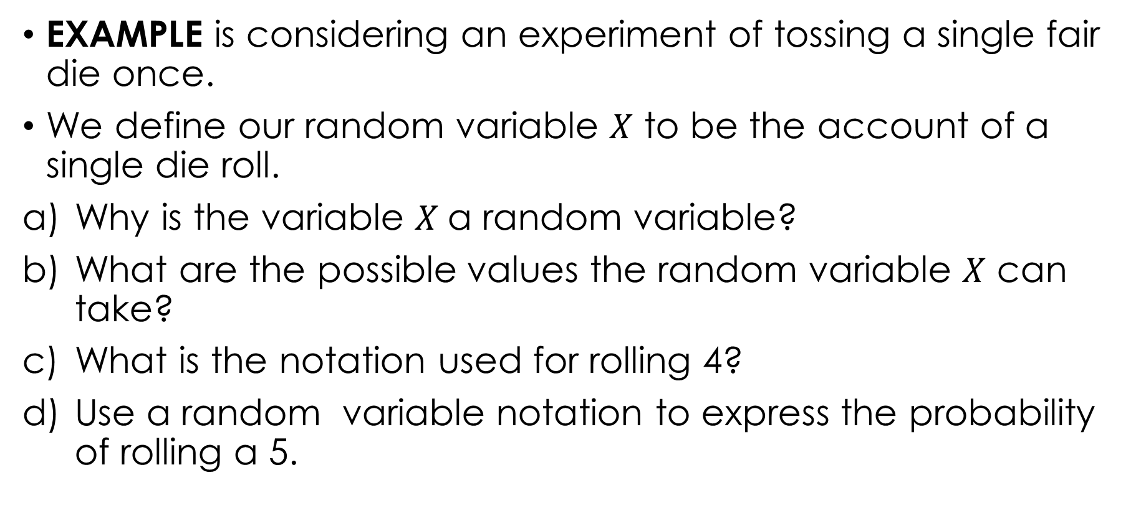
NOTATION FOR RANDOM VARIABLES
EXAMPLE is considering an experiment of tossing a single fair die once.
We define our random variable $X$ to be the account of a single die roll.
Why is the variable $X$a random variable?
What are the possible values the random variable $X$ can take?
What is the notation used for rolling 4?
Use a random variable notation to express the probability of rolling a 5.

Slide 6
NOTATION FOR RANDOM VARIABLES
EXAMPLE: Give the following random variables:
The number of cars owned by the family
The length of your desk in the classroom
The number of games played by Chelsea football Club in 2020/2021 premier league fixtures

Slide 7
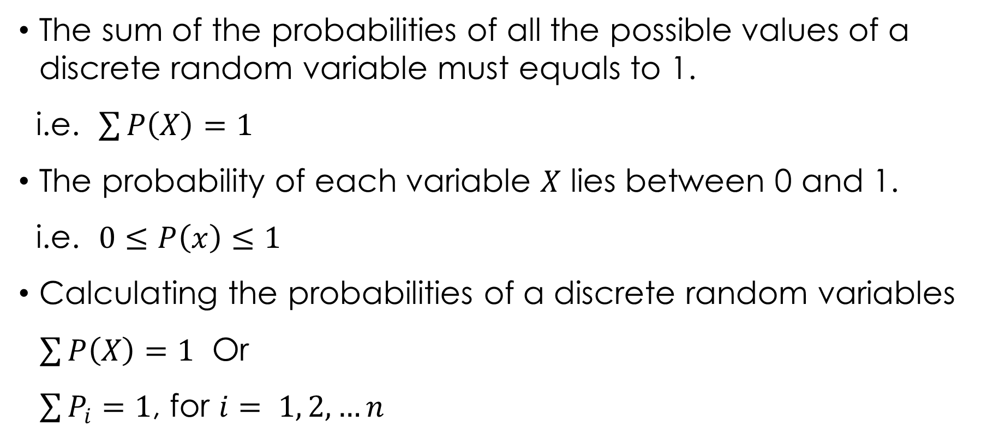
RULES FOR DISCRETE PROBABILITY DISTRIBUTION
The sum of the probabilities of all the possible values of a discrete random variable must equals to 1.
i.e. $\sum{P\left(X\right)=1}$
The probability of each variable $X$ lies between 0 and 1.
i.e. $0≤P\left(x\right)≤1$
Calculating the probabilities of a discrete random variables
$\sum{P\left(X\right)=1}$ Or
$\sum{P_{i}=1}$, for $i= 1, 2, …n$

Slide 8

Example 3.1
The discrete random variable $X$ has the given probability distribution:
Find $P\left(1≤X≤3\right)$
Find $P\left(X>2\right)$
Find $P\left(2<X<5\right)$

Slide 9

Solution 3.1
$\sum_{i}{P\left(X=x\right)=1}$
$=>$ $0.2+0.25+0.4+a+0.05=1$
$a+0.9=1$
$a=0.1$
Now:

Slide 10
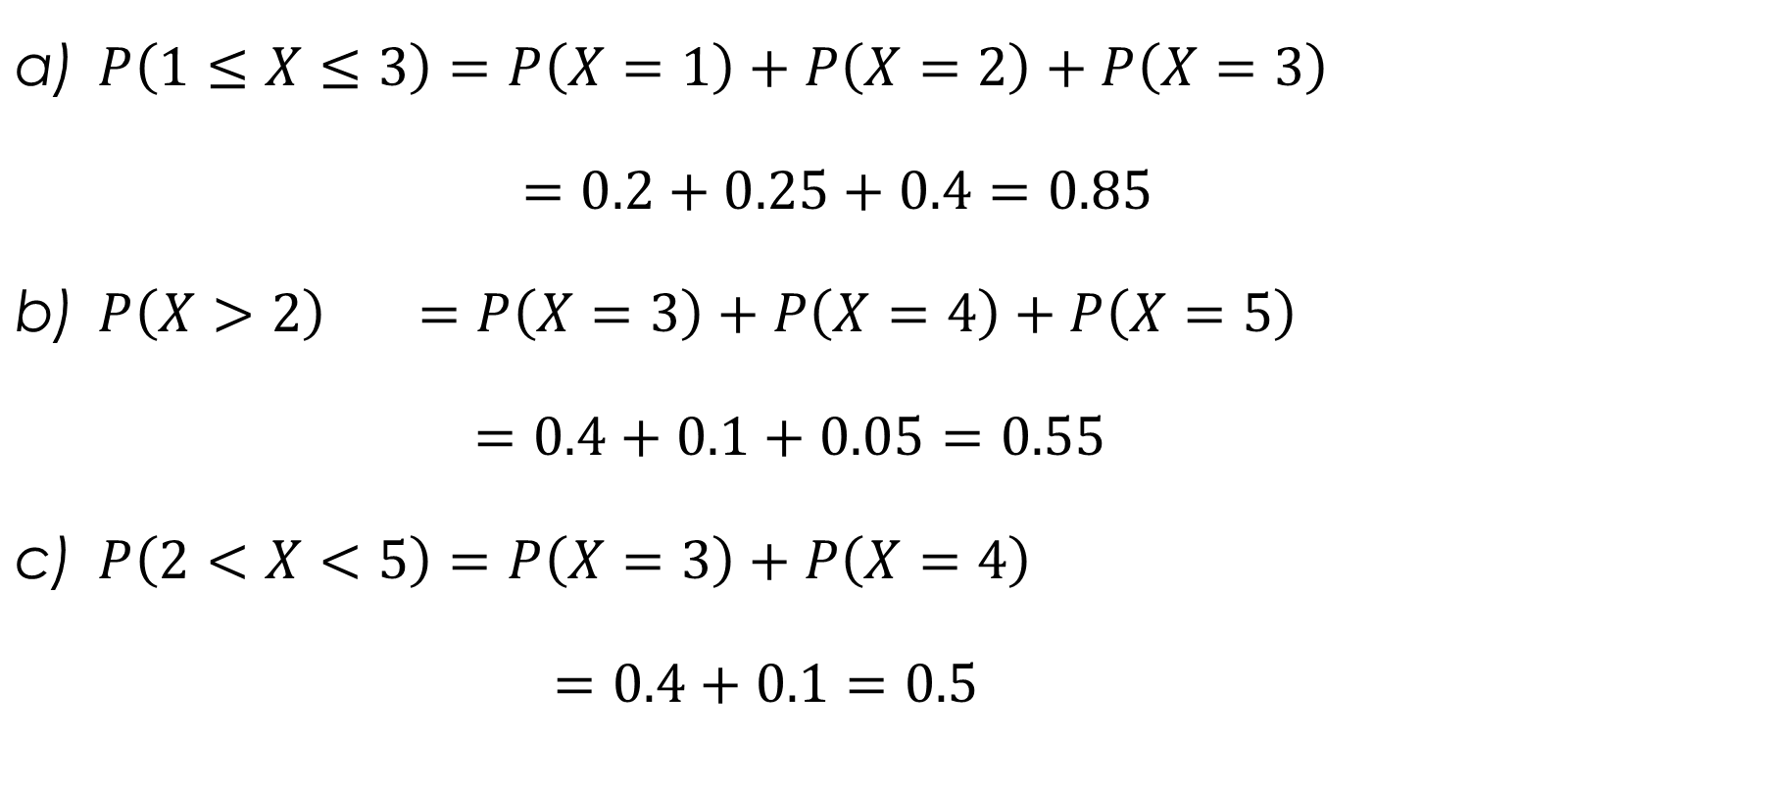
Solution 3.1 cont’d.
$P\left(1≤X≤3\right)=P\left(X=1\right)+P\left(X=2\right)+P\left(X=3\right)$
$=0.2+0.25+0.4=0.85$
$P\left(X>2\right) =P\left(X=3\right)+P\left(X=4\right)+P\left(X=5\right)$
$=0.4+0.1+0.05=0.55$
$P\left(2<X<5\right)=P\left(X=3\right)+P\left(X=4\right)$
$=0.4+0.1=0.5$

Slide 11

Example 3.2
The probability density function of a discrete random variable $X$ is given by $P\left(X=x\right)=kx$ for $x=12, 13, 14.$
Write out the probability distribution and find the value of k.
To find k,
$$\sum{P\left(X=x\right)=1}$$
$12k+13k+14k=1$
$k=1/39$
Solution 3.2

Slide 12
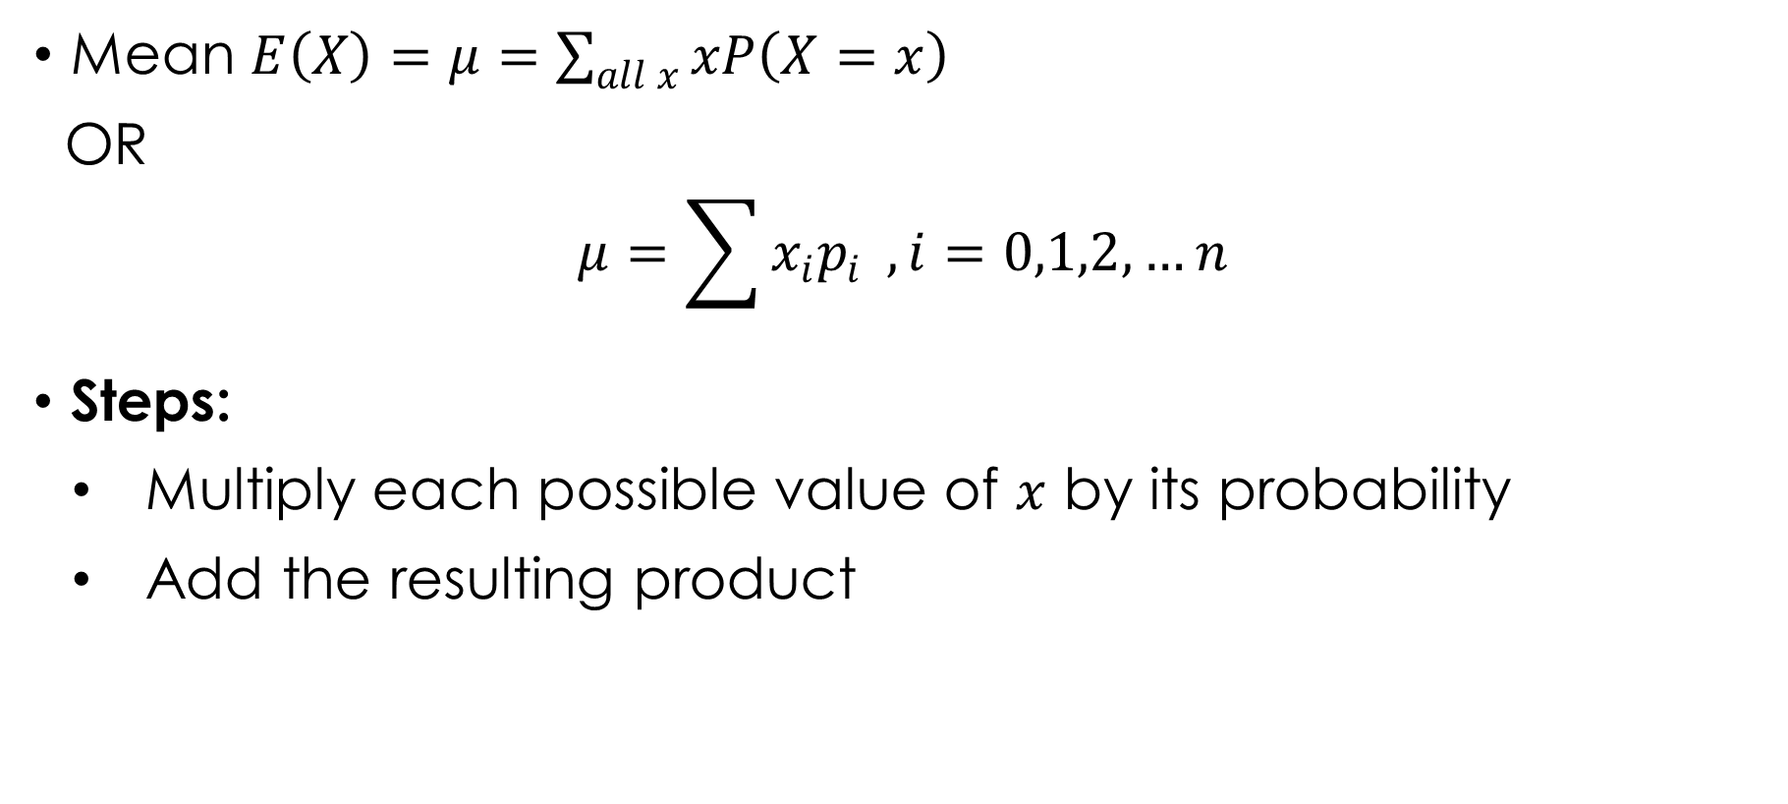
MEAN AND VARIABILITY OF DISCRETE R.V.
Mean $E\left(X\right)=μ=\sum_{all x}{xP\left(X=x\right)}$
OR
$$μ=\sum{x_{i}p_{i}} , i=0,1,2,…n$$
Steps:
Multiply each possible value of $x$ by its probability
Add the resulting product

Slide 13

Example 3.3
The probability distribution of the random variable X is shown in the table:
Find $E\left(X\right)$

Slide 14

Solution 3.3
$$E\left(X\right)=\sum_{all x}{xP\left(X=x\right)}$$
$=>0×\frac{1}{6}+1×\frac{1}{12}+2×\frac{1}{4}+3×\frac{1}{3}+4×\frac{1}{6}=2.25$

Slide 15

Example 3.4
The random variable X has the probability density function $\left(\text{p}\text{.}\text{d}\text{.}\text{f}\right)\text{: }\text{P}\left(\text{X}\text{=}\text{x}\right) \text{for} \text{x}\text{=5, 6,7,8,9 }\text{as} \text{defined} \text{in} \text{the} \text{table}$.
Find $μ$

Slide 16

Solution 3.4
$$E\left(X\right)=\sum_{all x}{xP\left(X=x\right)}$$
$=>μ=5×\frac{3}{11}+6×\frac{2}{11}+7×\frac{1}{11}+8×\frac{2}{11}+9×\frac{3}{11}=7$

Slide 17
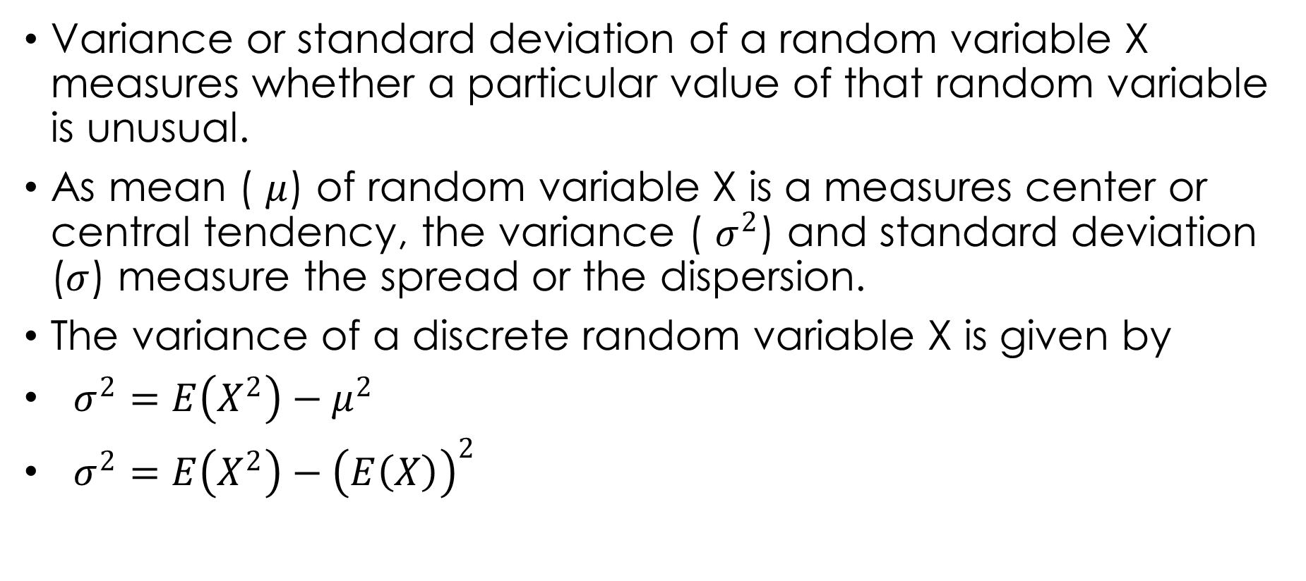
VARIABILITY OF A DISCRETE RANDOM VARIABLE
Variance or standard deviation of a random variable X measures whether a particular value of that random variable is unusual.
As mean ( $μ$) of random variable X is a measures center or central tendency, the variance ( $σ^{2}$) and standard deviation ($σ$) measure the spread or the dispersion.
The variance of a discrete random variable X is given by
$σ^{2}=E\left(X^{2}\right)−μ^{2}$
$σ^{2}=E\left(X^{2}\right)−{\left(E\left(X\right)\right)}^{2}$

Slide 18

VARIABILITY OF A DISCRETE RANDOM VARIABLE
$σ^{2}=E\left(X^{2}\right)−{\left(E\left(X\right)\right)}^{2}$
$E\left(X^{2}\right)=\sum_{all x}{x^{2}P\left(X=x\right)}$
$E\left(X\right)=\sum_{all x}{xP\left(X=x\right)}$
Standard deviation ($σ)=\sqrt{variance }=\sqrt{σ^{2}}$

Slide 19
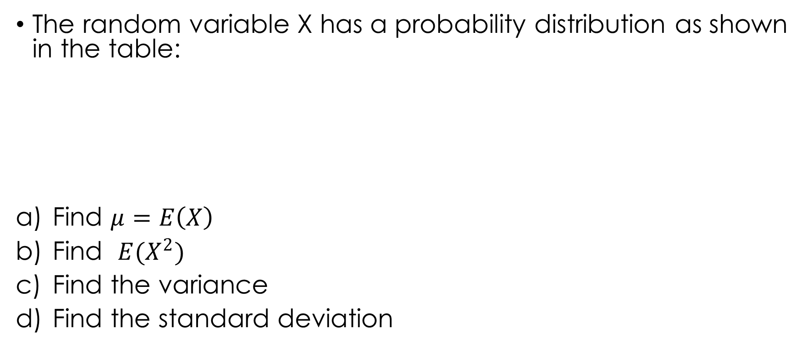
Example 3.5
The random variable X has a probability distribution as shown in the table:
Find $μ=E\left(X\right)$
Find $E(X^{2})$
Find the variance
Find the standard deviation

Slide 20
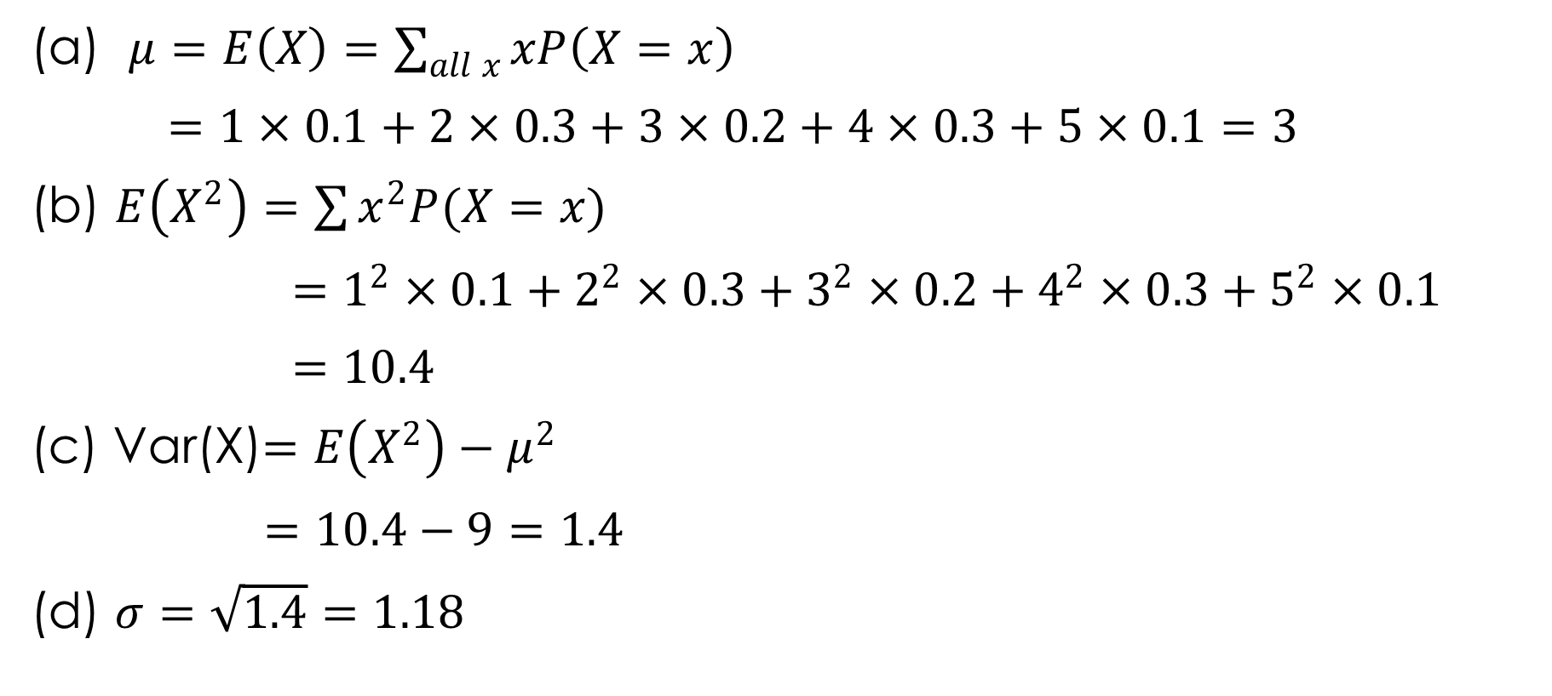
Solution 3.5
(a) $μ=E\left(X\right)=\sum_{all x}{xP\left(X=x\right)}$
$=1×0.1+2×0.3+3×0.2+4×0.3+5×0.1=3$
(b) $E\left(X^{2}\right)=\sum{x^{2}P(X=x)}$
$=1^{2}×0.1+2^{2}×0.3+3^{2}×0.2+4^{2}×0.3+5^{2}×0.1$
$=10.4$
(c) Var(X)$=E\left(X^{2}\right)−μ^{2}$
$=10.4−9=1.4$
(d) $σ=\sqrt{1.4}=1.18$

Slide 21
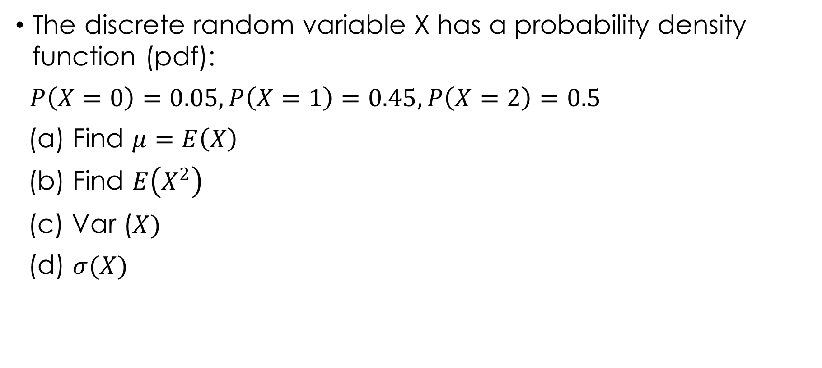
Example 3.6
The discrete random variable X has a probability density function (pdf):
$P\left(X=0\right)=0.05, P\left(X=1\right)=0.45, P\left(X=2\right)=0.5$
(a) Find $μ=E\left(X\right)$
(b) Find $E\left(X^{2}\right)$
(c) Var ($X)$
(d) $σ(X)$

Slide 22

Solution 3.6
(a) $μ=\sum{xP(X=x)}$
$=0×0.05+1×0.45+2×0.5=1.45$
(b) $E\left(X^{2}\right)=0^{2}×0.05+1^{2}×0.45+2^{2}×0.5=2.45$
(c) Var ($X^{2})=E\left(X^{2}\right)−μ^{2}$
$=2.45−{\left(1.45\right)}^{2}=0.35$
(d) $σ=\sqrt{0.35}=0.59$

Slide 23

Results Relating to Expectation and Variance
Given that $\text{a} \text{and} \text{b} \text{are} \text{constant}$
$E\left(a\right)=a$
$E\left(aX\right)=aE(X)$
$E\left(aX+b\right)=aE\left(X\right)+b$
$Var\left(a\right)=0$
$Var\left(aX\right)=a^{2}Var(X)$
$Var\left(aX+b\right)=a^{2}Var(X)$

Slide 24
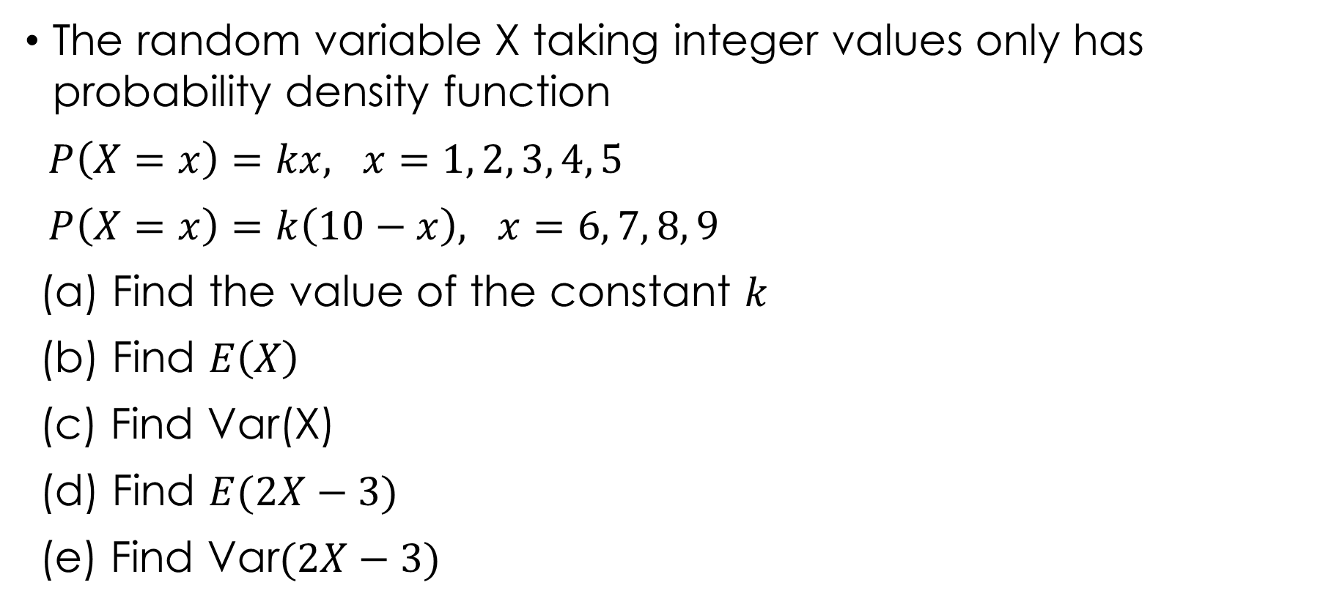
Example 3.7
The random variable X taking integer values only has probability density function
$P\left(X=x\right)=kx, x=1, 2, 3, 4, 5$
$P\left(X=x\right)=k\left(10−x\right), x=6, 7, 8, 9$
(a) Find the value of the constant $k$
(b) Find $E\left(X\right)$
(c) Find Var(X)
(d) Find $E(2X−3)$
(e) Find Var$(2X−3)$

Slide 25

Solution 3.7
To find k,
(a) $\sum{P\left(X=x\right)=1}$
$k+2k+3k+4k+5k+4k+3k+2k+k=1$
$25k=1$
$=>k=1/25$

Slide 26
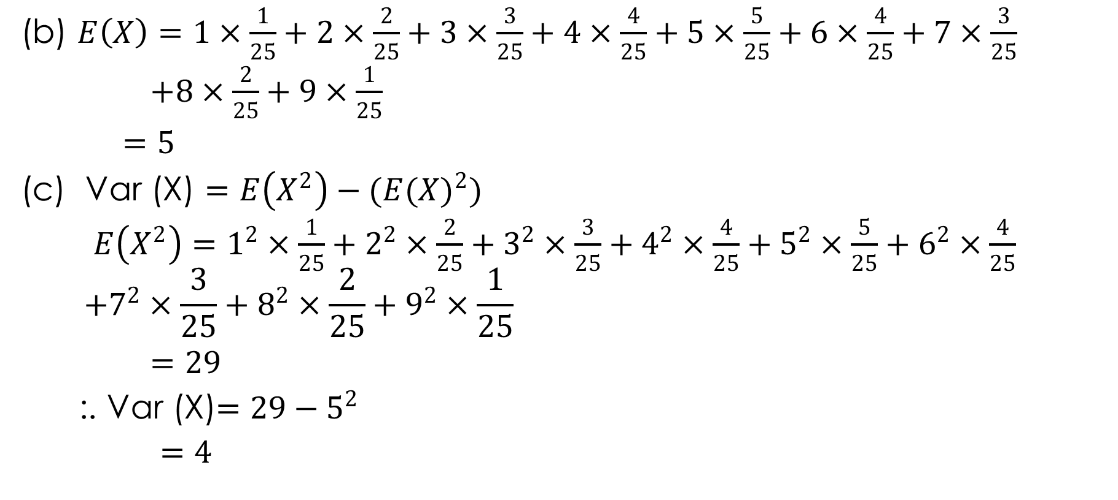
Solution 3.7 cont’d.
(b) $E\left(X\right)=1×\frac{1}{25}+2×\frac{2}{25}+3×\frac{3}{25}+4×\frac{4}{25}+5×\frac{5}{25}+6×\frac{4}{25}+7×\frac{3}{25}$
$+8×\frac{2}{25}+9×\frac{1}{25}$
$=5$
(c) Var (X) $=E\left(X^{2}\right)−(E({X)}^{2})$
$E\left(X^{2}\right)=1^{2}×\frac{1}{25}+2^{2}×\frac{2}{25}+3^{2}×\frac{3}{25}+4^{2}×\frac{4}{25}+5^{2}×\frac{5}{25}+6^{2}×\frac{4}{25}$
$$+7^{2}×\frac{3}{25}+8^{2}×\frac{2}{25}+9^{2}×\frac{1}{25}$$
$=29$
:. Var (X)$=29−5^{2}$
$=4$

Slide 27

Solution 3.7 cont’d.
(d) $E\left(2X−3\right)=2E\left(X\right)−3$
$=2\left(5\right)−3=7$
(e) Var $\left(2X−3\right)=2^{2}Var\left(X\right)$
$=4\left(4\right)=16$

Slide 28
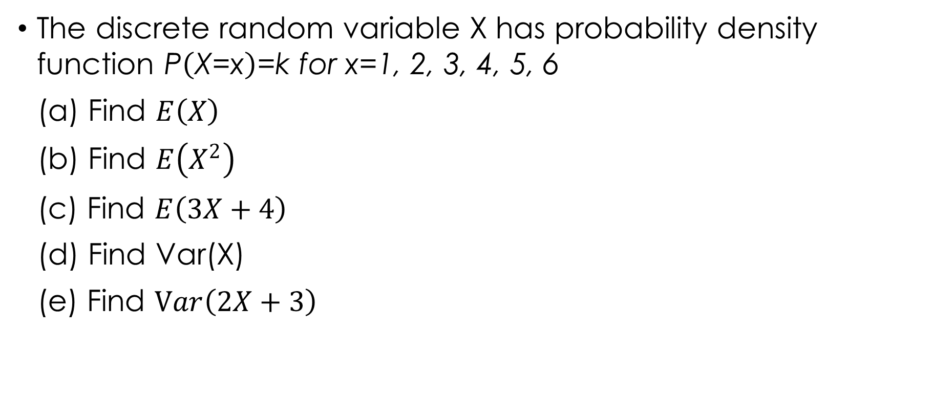
Example 3.8
The discrete random variable X has probability density function $\text{P}\left(\text{X}\text{=}\text{x}\right)\text{=}\text{k} \text{for} \text{x}\text{=1, 2, 3, 4, 5, 6}$
(a) Find $E\left(X\right)$
(b) Find $E\left(X^{2}\right)$
(c) Find $E\left(3X+4\right)$
(d) Find Var(X)
(e) Find $Var\left(2X+3\right)$

Slide 29

Solution 3.8
To find k,
$\sum_{all x}{P\left(X=x\right)=1}$
$k+k+k+k+k+k=1$
$k=\frac{1}{6}$
Now:

Slide 30
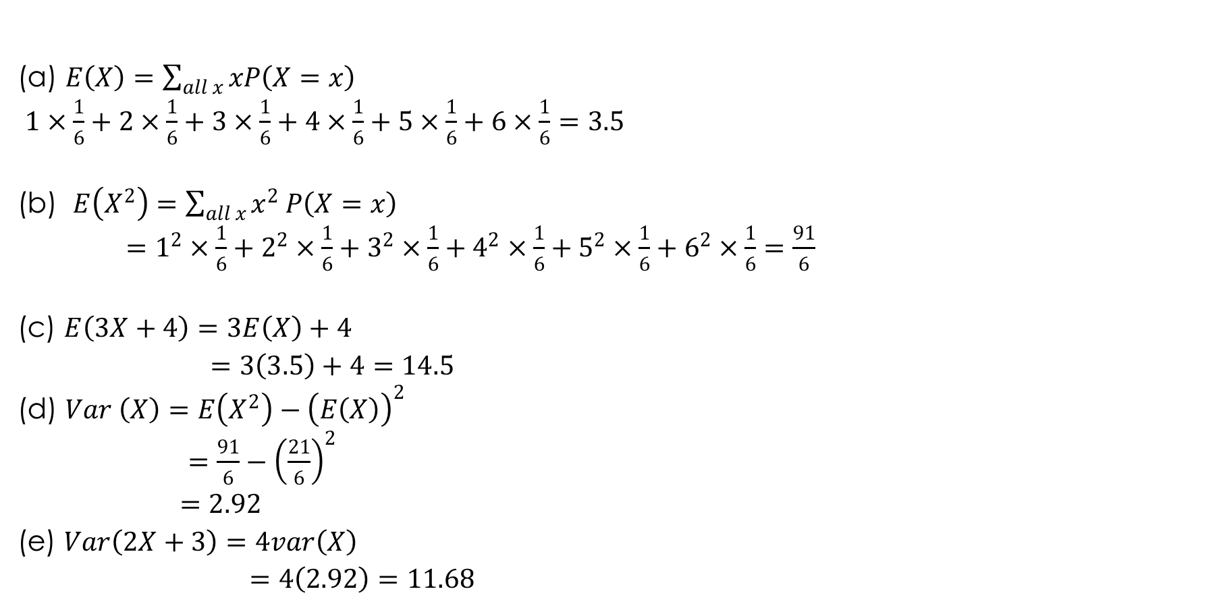
Solution 3.8 cont’d
(a) $E\left(X\right)=\sum_{all x}{xP\left(X=x\right)}$
$1×\frac{1}{6}+2×\frac{1}{6}+3×\frac{1}{6}+4×\frac{1}{6}+5×\frac{1}{6}+6×\frac{1}{6}=3.5$
(b) $E\left(X^{2}\right)=\sum_{all x}{x^{2}}P\left(X=x\right)$
$=1^{2}×\frac{1}{6}+2^{2}×\frac{1}{6}+3^{2}×\frac{1}{6}+4^{2}×\frac{1}{6}+5^{2}×\frac{1}{6}+6^{2}×\frac{1}{6}=\frac{91}{6}$
(c) $E\left(3X+4\right)=3E\left(X\right)+4$
$=3\left(3.5\right)+4=14.5$
(d) $Var \left(X\right)=E\left(X^{2}\right)−{\left(E\left(X\right)\right)}^{2}$
$=\frac{91}{6}−{\left(\frac{21}{6}\right)}^{2}$
$=2.92$
(e) $Var\left(2X+3\right)=4var\left(X\right)$
$=4\left(2.92\right)=11.68$

Slide 31
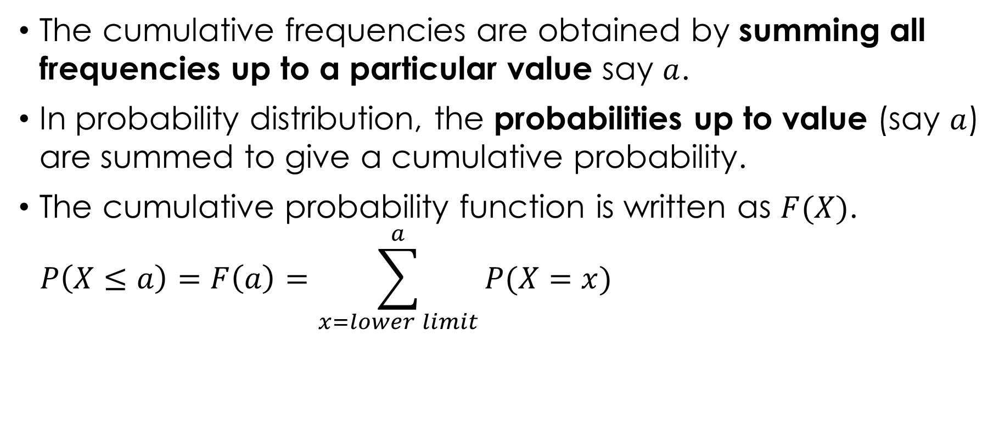
CUMULATIVE DISTRIBUTION FUNCTION FOR DISCRETE R.V.
The cumulative frequencies are obtained by summing all frequencies up to a particular value say $a$.
In probability distribution, the probabilities up to value (say $a$) are summed to give a cumulative probability.
The cumulative probability function is written as $F(X)$.
$$P\left(X≤a\right)=F\left(a\right)=\sum_{x=lower limit}^{a}{P(X=x)}$$

Slide 32
Example 3.9
The probability distribution of the random variable Y is shown in the table. Find the CDF.
Solution 3.9

Slide 33
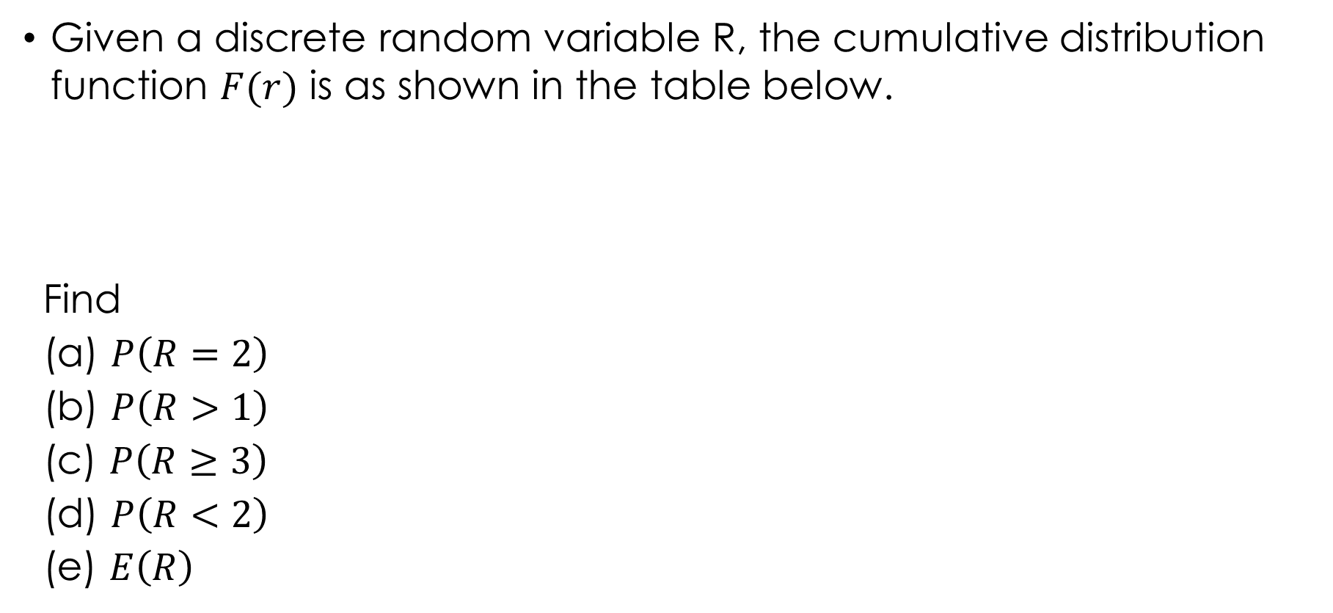
Example 3.10
Given a discrete random variable R, the cumulative distribution function $F(r)$ is as shown in the table below.
Find
(a) $P\left(R=2\right)$
(b) $P\left(R>1\right)$
(c) $P\left(R≥3\right)$
(d) $P\left(R<2\right)$
(e) $E\left(R\right)$

Slide 34
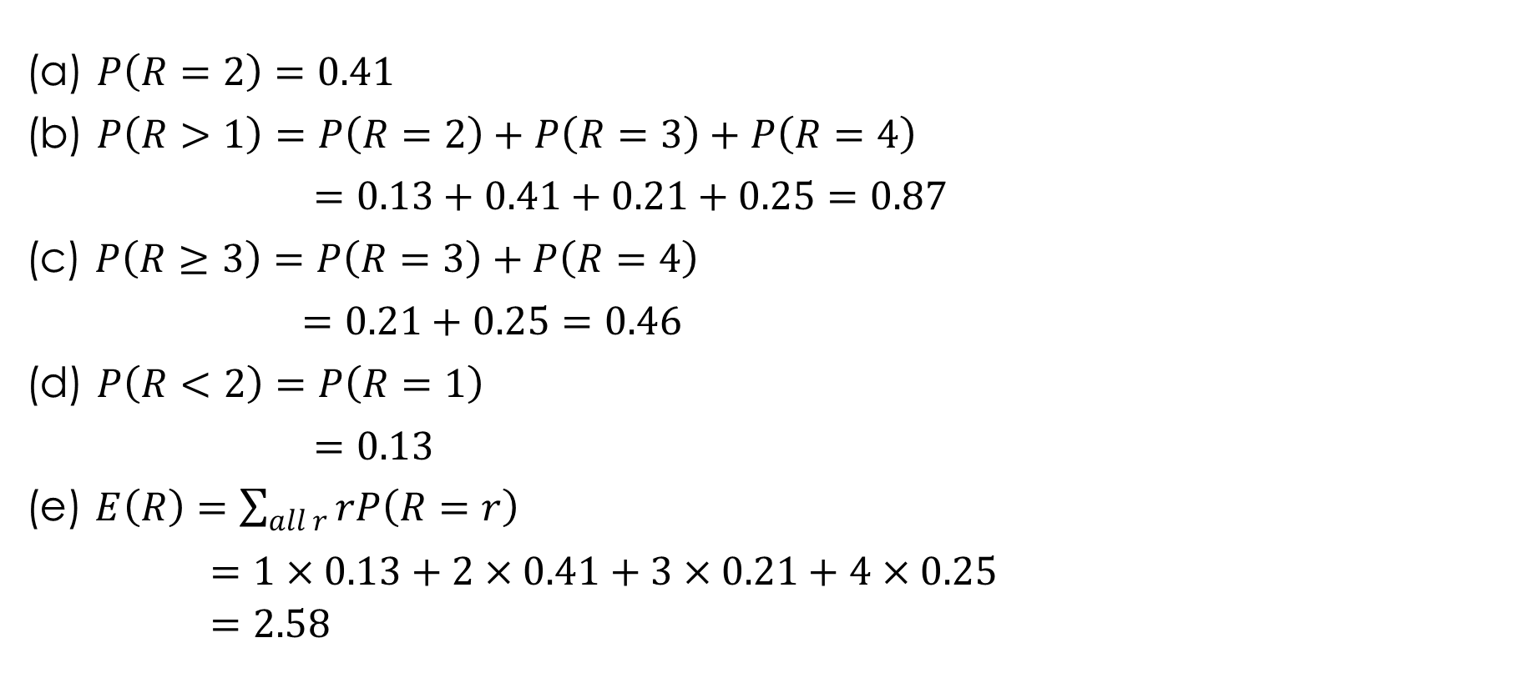
Solution 3.10
(a) $P\left(R=2\right)=0.41$
(b) $P\left(R>1\right)=P\left(R=2\right)+P\left(R=3\right)+P\left(R=4\right)$
$=0.13+0.41+0.21+0.25=0.87$
(c) $P\left(R≥3\right)=P\left(R=3\right)+P\left(R=4\right)$
$=0.21+0.25=0.46$
(d) $P\left(R<2\right)=P\left(R=1\right)$
$=0.13$
(e) $E\left(R\right)=\sum_{all r}{rP\left(R=r\right)}$
$=1×0.13+2×0.41+3×0.21+4×0.25$
$=2.58$

Slide 35
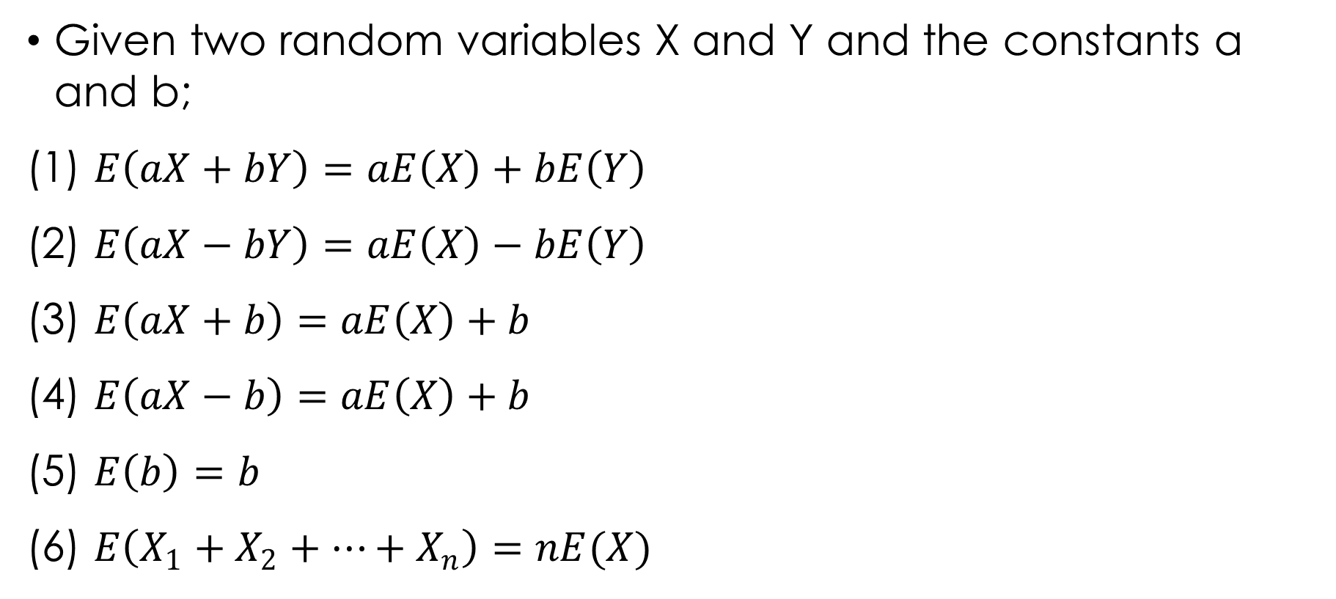
INDEPENDENT RANDOM VARIABLES
Given two random variables X and Y and the constants a and b;
(1) $E\left(aX+bY\right)=aE\left(X\right)+bE\left(Y\right)$
(2) $E\left(aX−bY\right)=aE\left(X\right)−bE\left(Y\right)$
(3) $E\left(aX+b\right)=aE\left(X\right)+b$
(4) $E\left(aX−b\right)=aE\left(X\right)+b$
(5) $E\left(b\right)=b$
(6) $E\left(X_{1}+X_{2}+…+X_{n}\right)=nE(X)$

Slide 36
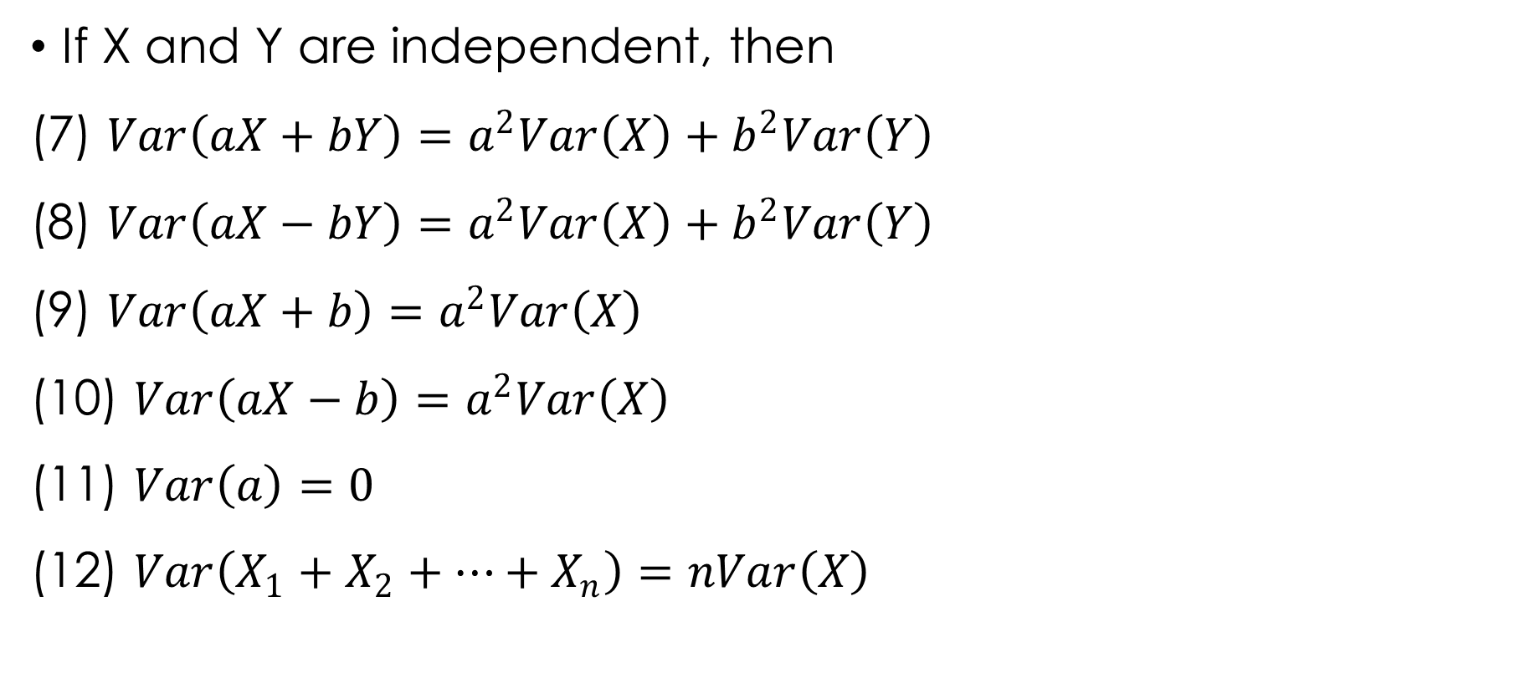
INDEPENDENT RANDOM VARIABLES cont’d.
If X and Y are independent, then
(7) $Var\left(aX+bY\right)=a^{2}Var\left(X\right)+b^{2}Var\left(Y\right)$
(8) $Var\left(aX−bY\right)=a^{2}Var\left(X\right)+b^{2}Var\left(Y\right)$
(9) $Var\left(aX+b\right)=a^{2}Var\left(X\right)$
(10) $Var\left(aX−b\right)=a^{2}Var\left(X\right)$
(11) $Var\left(a\right)=0$
(12) $Var\left(X_{1}+X_{2}+…+X_{n}\right)=nVar\left(X\right)$

Slide 37
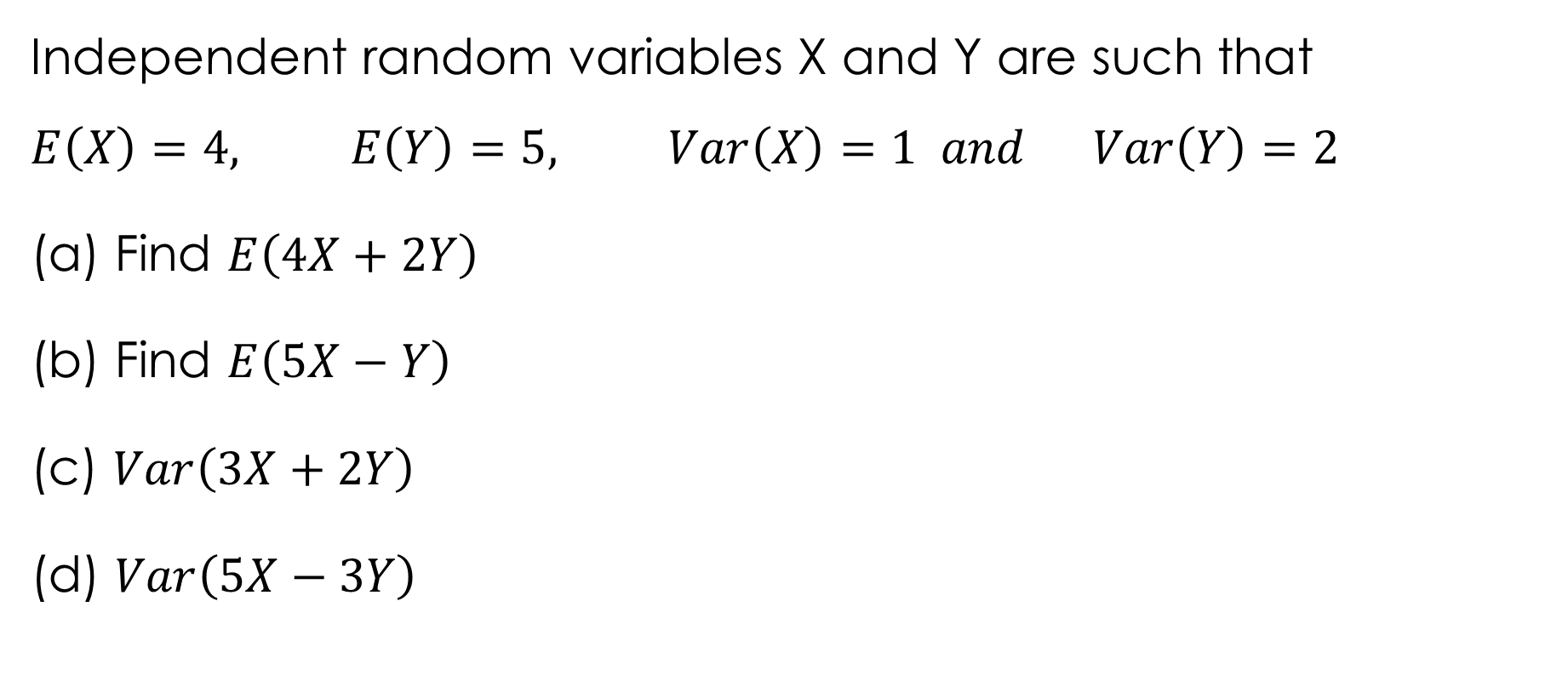
Example 3.11
Independent random variables X and Y are such that
$$E\left(X\right)=4, E\left(Y\right)=5, Var\left(X\right)=1 and Var\left(Y\right)=2$$
(a) Find $E\left(4X+2Y\right)$
(b) Find $E\left(5X−Y\right)$
(c) $Var\left(3X+2Y\right)$
(d) $Var\left(5X−3Y\right)$

Slide 38
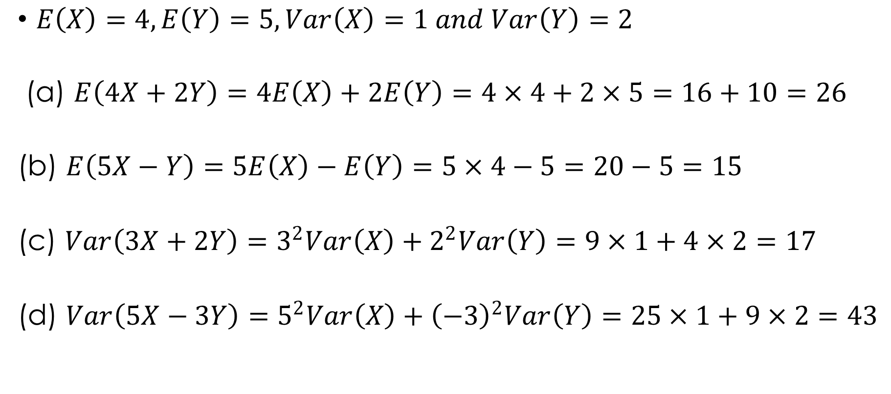
Solution 3.11
$E\left(X\right)=4, E\left(Y\right)=5, Var\left(X\right)=1 and Var\left(Y\right)=2$
(a) $E\left(4X+2Y\right)=4E\left(X\right)+2E\left(Y\right)=4×4+2×5=16+10=26$
(b) $E\left(5X−Y\right)=5E\left(X\right)−E\left(Y\right)=5×4−5=20−5=15$
(c) $Var\left(3X+2Y\right)=3^{2}Var\left(X\right)+2^{2}Var\left(Y\right)=9×1+4×2=17$
(d) $Var\left(5X−3Y\right)=5^{2}Var\left(X\right)+{\left(−3\right)}^{2}Var\left(Y\right)=25×1+9×2=43$

Slide 39

Example 3.12
Independent random variables X and Y are such that $E\left(X^{2}\right)=14, E\left(Y^{2}\right)=20, Var\left(X\right)=10 and Var\left(Y\right)=11$
(a) Find $E\left(3X−2Y\right)$
(b) Find $Var\left(5X−2Y\right)$

Slide 40
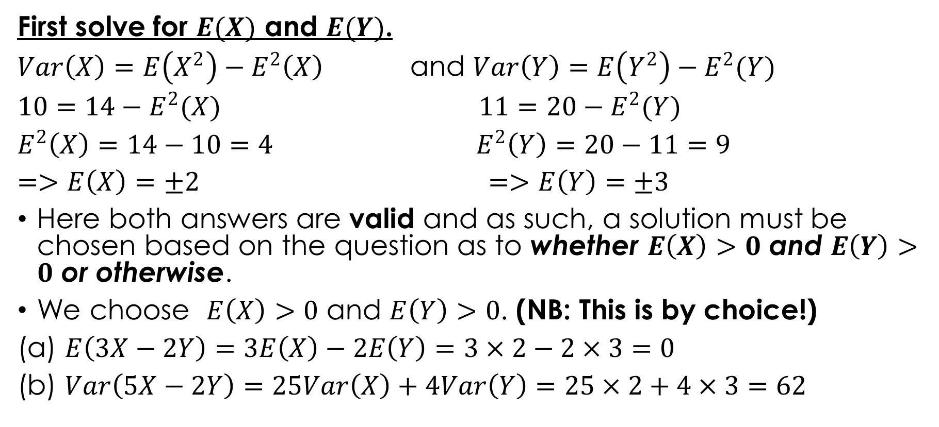
Solution 3.12
First solve for $E(X)$ and $E(Y)$.
$Var\left(X\right)=E\left(X^{2}\right)−E^{2}\left(X\right)$ and $Var\left(Y\right)=E\left(Y^{2}\right)−E^{2}(Y)$
$10=14−E^{2}(X)$ $11=20−E^{2}(Y)$
$E^{2}\left(X\right)=14−10=4$ $E^{2}\left(Y\right)=20−11=9$
$=>E\left(X\right)=±2$ $=>E\left(Y\right)=±3$
Here both answers are valid and as such, a solution must be chosen based on the question as to whether $E\left(X\right)>0$ and $E\left(Y\right)>0$ or otherwise.
We choose $E\left(X\right)>0$ and $E\left(Y\right)>0$. (NB: This is by choice!)
(a) $E\left(3X−2Y\right)=3E\left(X\right)−2E\left(Y\right)=3×2−2×3=0$
(b) $Var\left(5X−2Y\right)=25Var\left(X\right)+4Var\left(Y\right)=25×2+4×3=62$

Slide 41
CONTINUOUS RANDOM VARIABLES

Slide 42
CONTINUOUS RANDOM VARIABLES
Examples of continuous random variables:
The mass, grams, of bag of sugar packaged by a particular machine.
The time taken, in minutes, to perform a task.
The height, in centimetres, of a ten-year old boy.
The lifetime, in hours, of a 100-watt light bulb.

Slide 43

PROBABILITY DENSITY FUNCTION OF CONTINUOUS R.V.
Continuous random variable $X$, with p.d.f, $f(x)$ is valid over the range, $a≤x≤b$ if
$\int_{a}^{b}{f(x)}dx=1$
$for a≤x_{1}<x_{2}≤b$
$P\left(x_{1}≤X≤x_{2}\right)=\int_{x_{1}}^{x_{2}}{f(x)}dx$

Slide 44

Example 3.13
A continuous random variable had p.d.f $f\left(x\right)=kx^{2} for 0≤x≤4$.
Find the value of the constant $k$.
Find $P(1≤X≤3)$.

Slide 45

Solution 3.13
$\int_{0}^{4}{f(x)}dx=1$
$$\int_{0}^{4}{kx^{2}}dx=1$$
$${\left[\frac{kx^{3}}{3}\right]}_{0}^{4}=1$$
$$\frac{64}{3}k=1$$
$$k=\frac{3}{64}$$
$∴f\left(x\right)=\frac{3x^{2}}{64}, for 0≤x≤4$.

Slide 46

Solution 3.13 cont’d.
$P\left(1≤X≤3\right)=\int_{0}^{3}{\frac{3}{64}x^{2}}dx$
$$=\frac{3}{64}{\left[\frac{x^{3}}{3}\right]}_{0}^{3}$$
$$=\frac{3}{64}\left[\frac{3^{3}}{3}−\frac{1^{3}}{3}\right]$$
$$=\frac{3}{64}\left[9−\frac{1}{3}\right]$$
$$=0.41$$

Slide 47
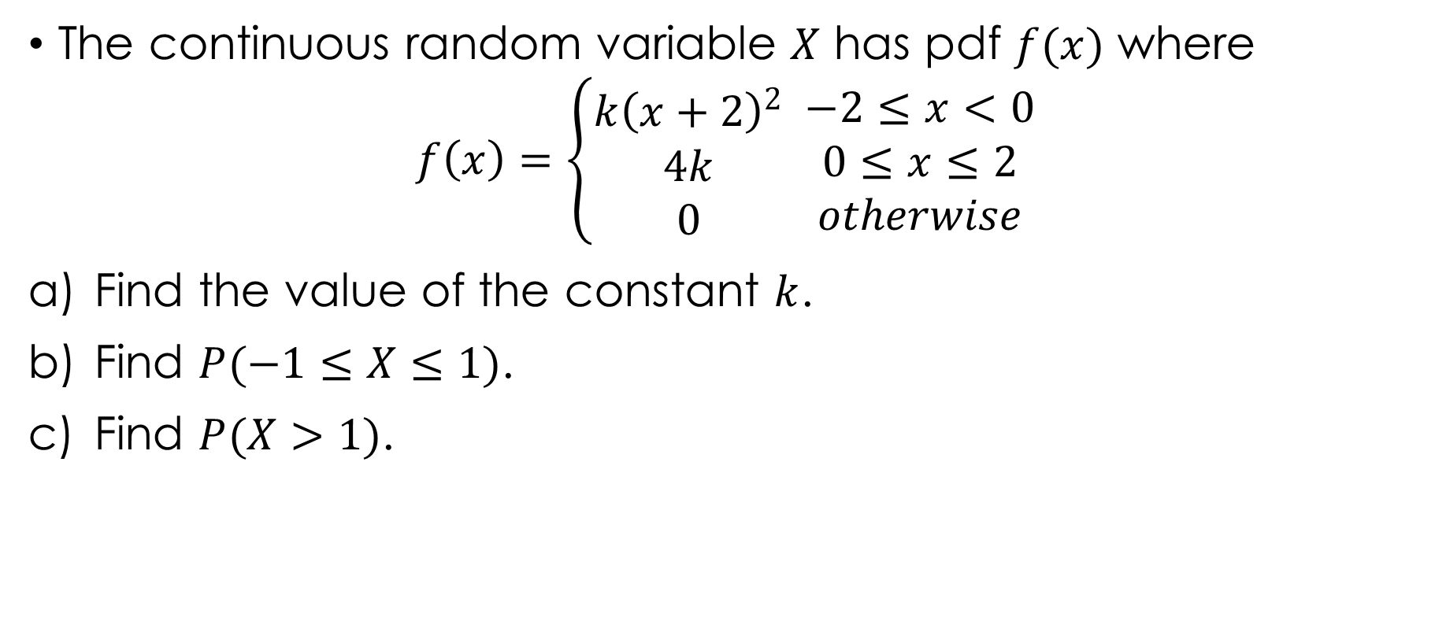
Example 3.14
The continuous random variable $X$ has pdf $f(x)$ where
$$f\left(x\right)=\left\{\begin{aligned}k{\left(x+2\right)}^{2} \\ 4k \\ 0\end{aligned} \begin{matrix}−2≤x<0 \\ 0≤x≤2 \\ otherwise\end{matrix}\right.$$
Find the value of the constant $k$.
Find $P(−1≤X≤1)$.
Find $P(X>1)$.

Slide 48

Solution 3.14
To find $k$, $\int_{all x}{f\left(x\right)}dx=1$
$\int_{−2}^{0}{k{\left(x+2\right)}^{2}}dx+\int_{0}^{2}{4k}dx=1$
$\frac{k}{3}{\left[{\left(x+2\right)}^{3}\right]}_{−2}^{0}+k{\left[4x\right]}_{0}^{2}=1$
$\frac{k}{3}\left[{\left(0+2\right)}^{3}−{\left(−2+2\right)}^{3}\right]+4k\left[2−0\right]=1$
$\frac{k}{3}\left[8\right]+\left[8k\right]=1$
$k\left[\frac{8}{3}+8\right]=1$
$\frac{32}{3}k=1$
$k=\frac{3}{32}$

Slide 49
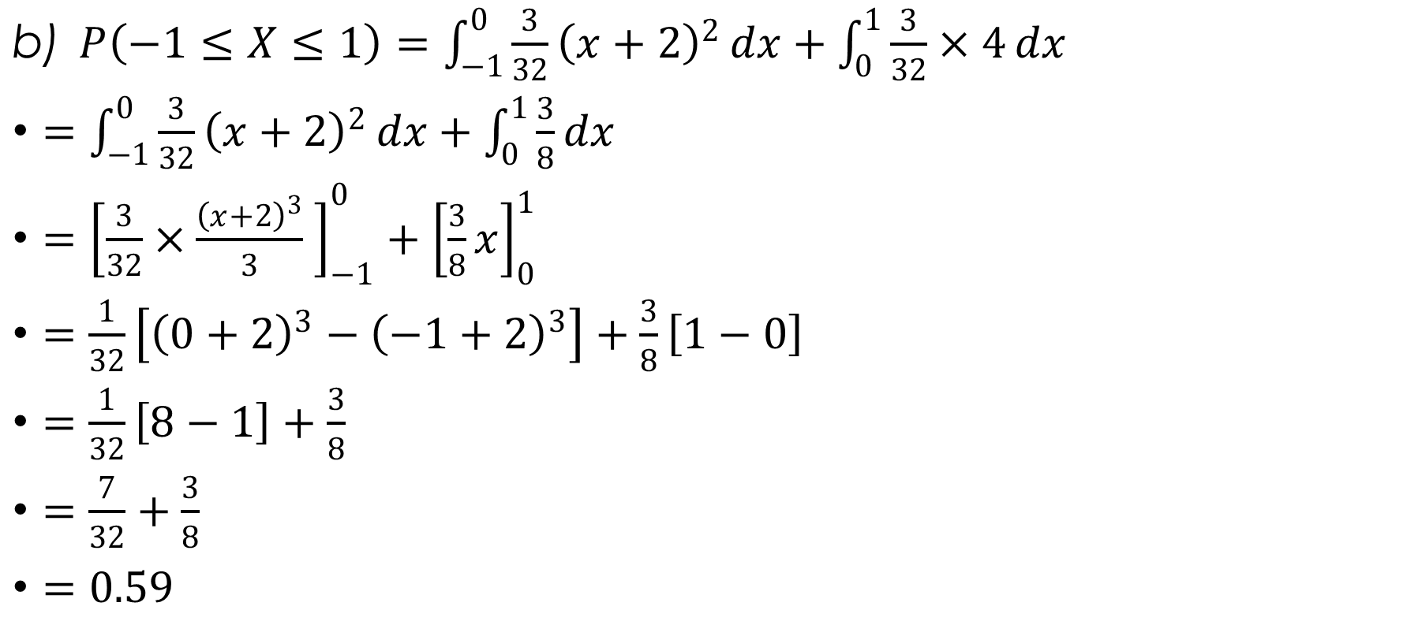
Solution 3.14 cont’d.
$P\left(−1≤X≤1\right)=\int_{−1}^{0}{\frac{3}{32}{\left(x+2\right)}^{2}}dx+\int_{0}^{1}{\frac{3}{32}×4}dx$
$=\int_{−1}^{0}{\frac{3}{32}{\left(x+2\right)}^{2}}dx+\int_{0}^{1}{\frac{3}{8}}dx$
$={\left[\frac{3}{32}×\frac{{\left(x+2\right)}^{3}}{3} \right]}_{−1}^{0}+{\left[\frac{3}{8}x\right]}_{0}^{1}$
$=\frac{1}{32}\left[{\left(0+2\right)}^{3}−{\left(−1+2\right)}^{3}\right]+\frac{3}{8}\left[1−0\right]$
$=\frac{1}{32}\left[8−1\right]+\frac{3}{8}$
$=\frac{7}{32}+\frac{3}{8}$
$=0.59$

Slide 50

Solution 3.14 cont’d.
$P\left(X>1\right)=\int_{1}^{2}{\frac{3}{32}×4}dx$
$=\frac{3}{8}{\left[x\right]}_{1}^{2}$
$=\frac{3}{8}\left[2−1\right]$
$=\frac{3}{8}$
$=0.38$

Slide 51
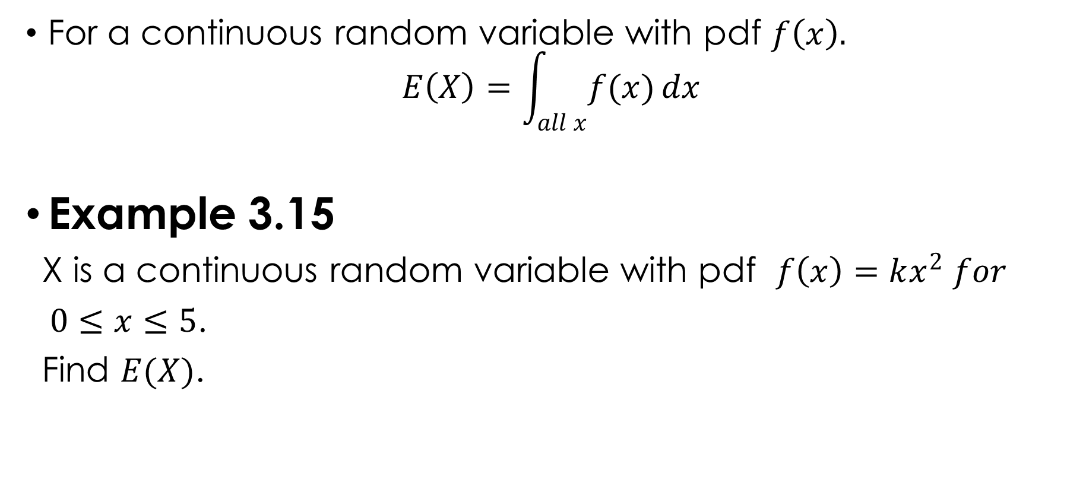
EXPECTATION OF X, $E(X)$
For a continuous random variable with pdf $f\left(x\right).$
$$E\left(X\right)=\int_{all x}{f(x)}dx$$
Example 3.15
X is a continuous random variable with pdf $f\left(x\right)=kx^{2} for$
$0≤x≤5$.
Find $E(X)$.

Slide 52
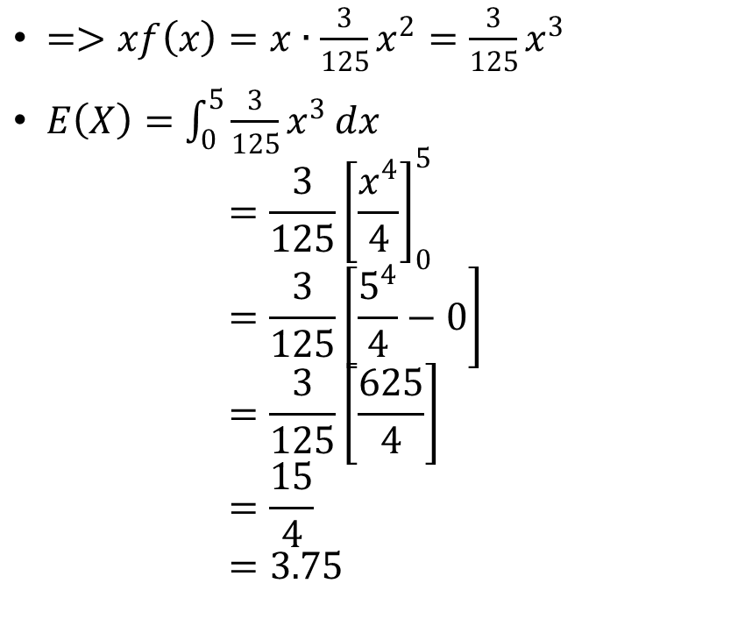
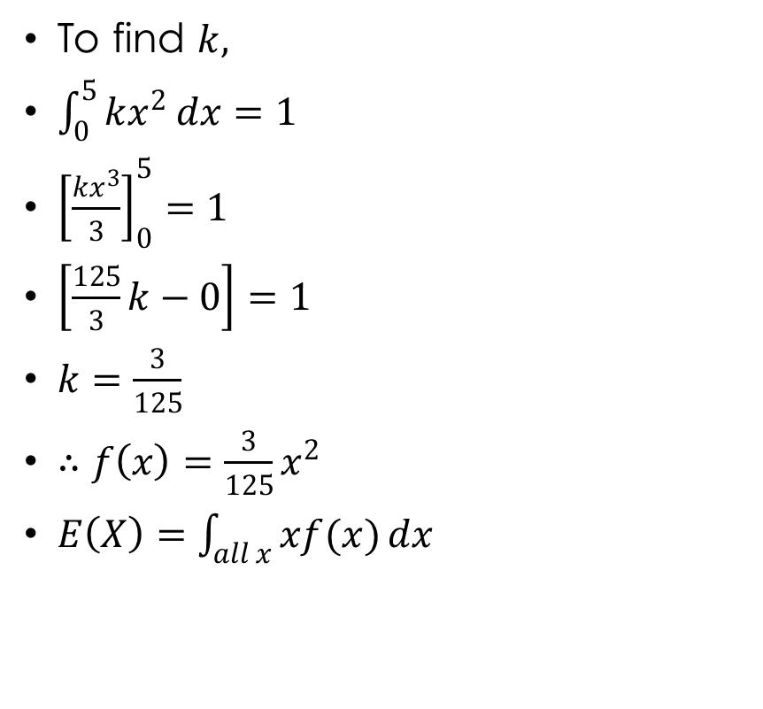
Solution 3.15
To find $k,$
$\int_{0}^{5}{kx^{2}}dx=1$
${\left[\frac{kx^{3}}{3}\right]}_{0}^{5}=1$
$\left[\frac{125}{3}k−0\right]=1$
$k=\frac{3}{125}$
$∴f\left(x\right)=\frac{3}{125}x^{2}$
$E\left(X\right)=\int_{all x}{xf(x)}dx$
$=>xf\left(x\right)=x∙\frac{3}{125}x^{2}=\frac{3}{125}x^{3}$
$E\left(X\right)=\int_{0}^{5}{\frac{3}{125}x^{3}}dx$ $=\frac{3}{125}{\left[\frac{x^{4}}{4}\right]}_{0}^{5}$ $=\frac{3}{125}\left[\frac{5^{4}}{4}−0\right]$ $=\frac{3}{125}\left[\frac{625}{4}\right]$ $=\frac{15}{4}$ $=3.75$

Slide 53

Example 3.16
A random variable X has a pdf $f(x)$ given by
$f\left(x\right)=cx\left(5−x\right), 0≤x≤5.$
Find the mean of X.

Slide 54
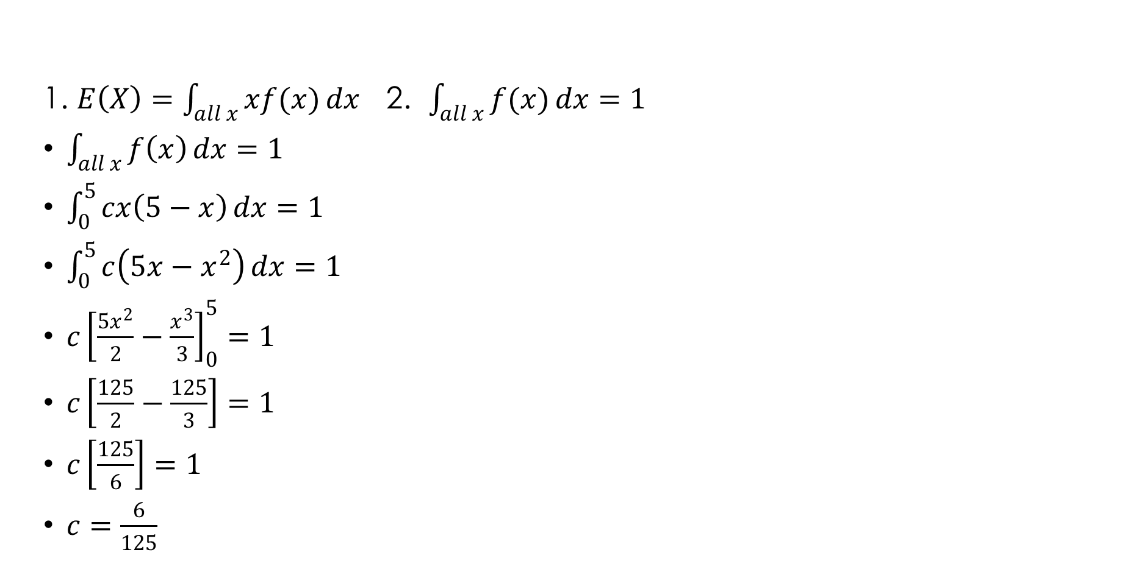
Solution 3.16
1. $E\left(X\right)=\int_{all x}{xf(x)}dx$ 2. $\int_{all x}{f(x)}dx=1$
$\int_{all x}{f\left(x\right)}dx=1$
$\int_{0}^{5}{cx\left(5−x\right)}dx=1$
$\int_{0}^{5}{c\left(5x−x^{2}\right)}dx=1$
${c\left[\frac{5x^{2}}{2}−\frac{x^{3}}{3}\right]}_{0}^{5}=1$
$c\left[\frac{125}{2}−\frac{125}{3}\right]=1$
$c\left[\frac{125}{6}\right]=1$
$c=\frac{6}{125}$

Slide 55
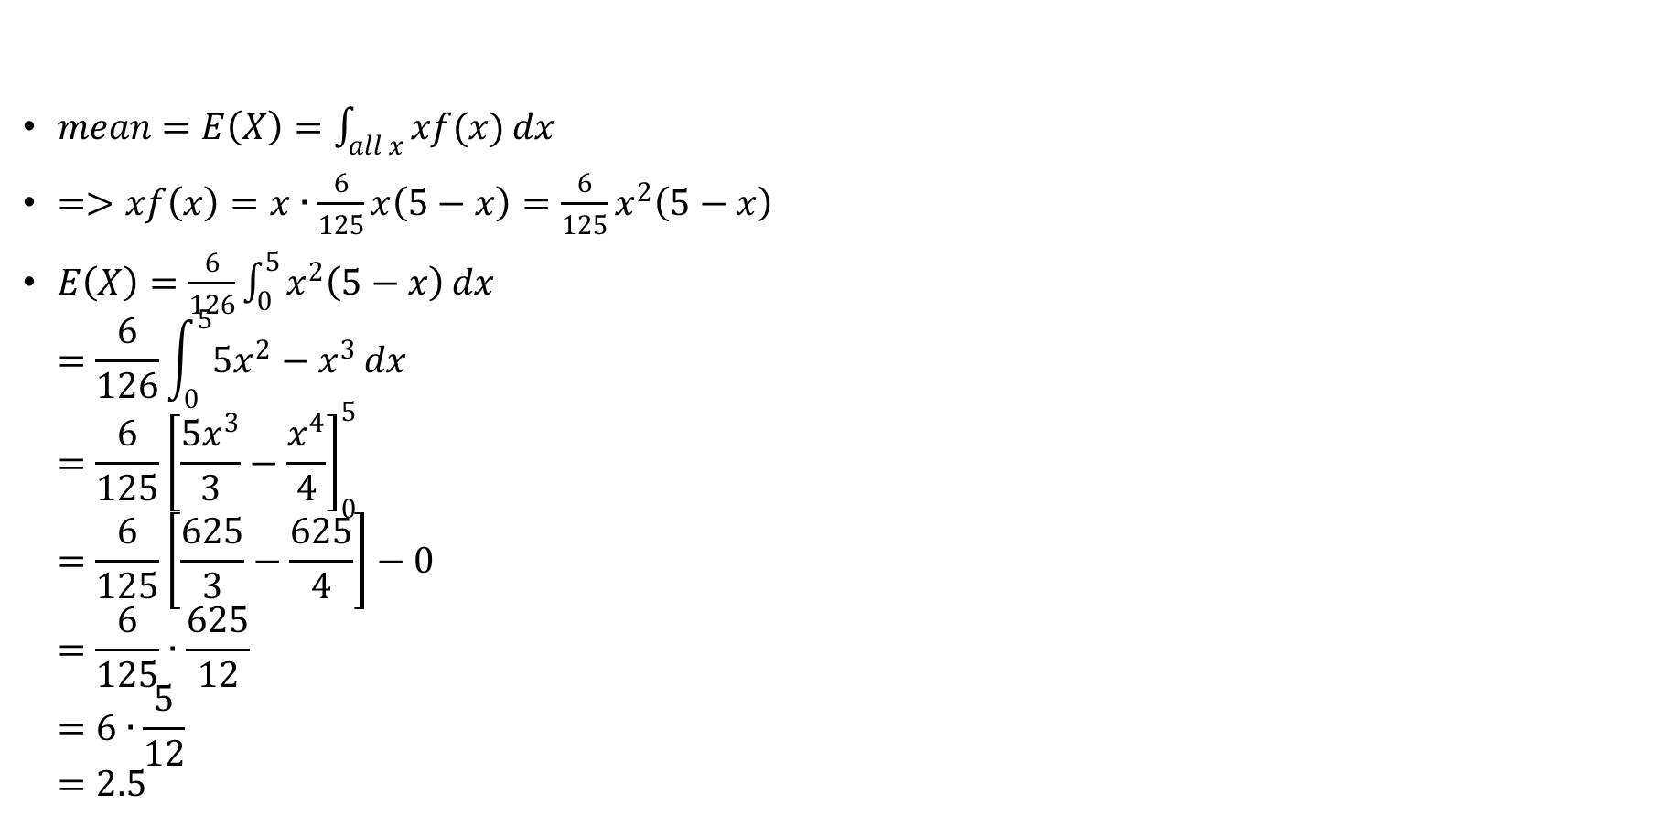
Solution 3.16 cont’d.
$mean=E\left(X\right)=\int_{all x}{xf(x)}dx$
$=>xf\left(x\right)=x∙\frac{6}{125}x\left(5−x\right)=\frac{6}{125}x^{2}\left(5−x\right)$
$E\left(X\right)=\frac{6}{126}\int_{0}^{5}{x^{2}\left(5−x\right)}dx$ $=\frac{6}{126}\int_{0}^{5}{{5x}^{2}−x^{3}}dx$ $=\frac{6}{125}{\left[\frac{5x^{3}}{3}−\frac{x^{4}}{4}\right]}_{0}^{5}$ $=\frac{6}{125}\left[\frac{625}{3}−\frac{625}{4}\right]−0$ $=\frac{6}{125}∙\frac{625}{12}$ $=6∙\frac{5}{12}$ $=2.5$

Slide 56
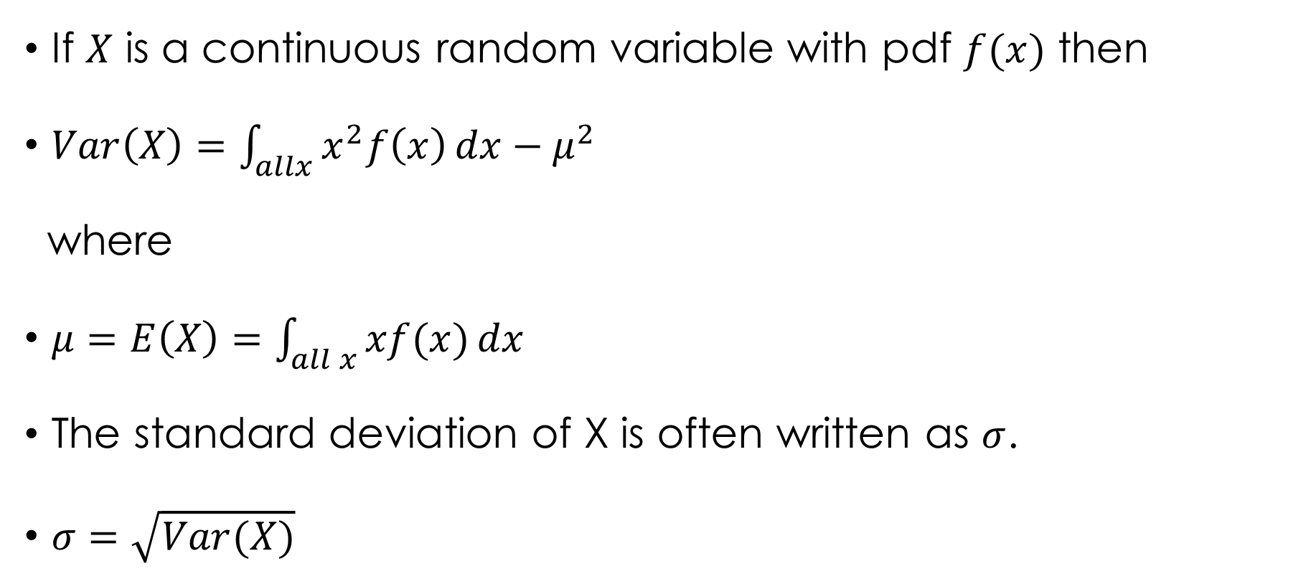
VARIANCE OF X, $Var(X)$
If $X$ is a continuous random variable with pdf $f(x)$ then
$Var\left(X\right)=\int_{allx}{x^{2}f\left(x\right)}dx−μ^{2}$
where
$μ=E\left(X\right)=\int_{all x}{xf(x)}dx$
The standard deviation of X is often written as $σ$.
$σ=\sqrt{Var(X)}$

Slide 57

Example 3.17
The continuous random variable X has pdf $f\left(x\right)=\frac{1}{8}x, 0≤x≤4.$
Find $E(X)$.
Find $E(X^{2})$.
Find $Var(X)$.
Find $σ_{X},$ the standard deviation of X.
Find $Var(3X+2)$.

Slide 58


Solution 3.17
$E\left(X\right)=\int_{allx}{xf\left(x\right)}dx$
$$=\int_{0}^{4}{\frac{1}{8}x^{2}}dx \\ =\frac{1}{8}{\left[\frac{x^{3}}{3}\right]}_{0}^{4} \\ =\frac{1}{8}\left[\frac{4^{3}}{3}−0\right] \\ =2.7$$
$E\left(X^{2}\right)=\int_{allx}{x^{2}f\left(x\right)}dx$
$$=\int_{0}^{4}{\frac{1}{8}x^{3}}dx \\ =\frac{1}{8}{\left[\frac{x^{4}}{4}\right]}_{0}^{4} \\ =\frac{1}{8}\left[\frac{4^{4}}{4}−0\right] \\ =8$$

Slide 59

Solution 3.17 cont’d.
$Var\left(X\right)=E\left(X^{2}\right)−{\left[E\left(X\right)\right]}^{2}=8−{2.7}^{2}=0.89$
$σ_{X}=\sqrt{Var\left(X\right)}=\sqrt{0.89}=0.94$
$Var\left(3X+2\right)=Var\left(3X\right)+Var\left(2\right)=3^{2}Var\left(X\right)+0=9×Var\left(X\right)$ $=9×0.89$ $=8.0$

Slide 60

Example 3.18
An experiment of temporary roundabout is installed at the crossroads, the time, X minutes, which vehicles have to wait before entering the roundabout has probability density function
$$f\left(x\right)=\left\{\begin{aligned}0.8−0.32x \\ 0\end{aligned} \begin{matrix}0≤x≤2.5 \\ otherwise\end{matrix}\right.$$
Find the mean and the standard deviation of X.

Slide 61

Solution 3.18
$E\left(X\right)=\int_{allx}{xf\left(x\right)}dx$ $=\int_{0}^{2.5}{\left(0.8x−0.32x^{2}\right)}dx$ $={\left[\frac{0.8x^{2}}{2}−\frac{0.32x^{3}}{3}\right]}_{0}^{2.5}$ $=\left[\frac{\left(0.8\right){2.5}^{2}}{2}−\frac{\left(0.32\right){2.5}^{3}}{3}\right]−0$ $=0.833 minutes$ $=50 seconds$ $∴The mean time is 50 seconds$

Slide 62

Solution 3.18 cont’d.
$E\left(X^{2}\right)=\int_{allx}{x^{2}f\left(x\right)}dx$ $=\int_{0}^{2.5}{0.8x^{2}−0.32x^{3}}dx$ $={\left[\frac{0.8x^{3}}{3}−\frac{0.32x^{4}}{4}\right]}_{0}^{2.5}$ $=\left[\frac{\left(0.8\right){2.5}^{3}}{4}−\frac{\left(0.32\right){2.5}^{4}}{4}\right]−0$ $=1.041$
$Var\left(X\right)=E\left(X^{2}\right)−E^{2}\left(X\right)$ $=1.041−{\left(0.833\right)}^{2}$ $=0.347$
$SD\left(X\right)=\sqrt{Var\left(X\right)}=\sqrt{0.347}=0.589$
The standard deviation is 35 seconds.

Slide 63

THE CUMULATIVE DISTRIBUTION FUNCTION, $F(x)$
If $f(x)$ is valid in the range $a≤x≤b$
Then
$$F\left(t\right)=\int_{a}^{t}{f\left(x\right)}dx$$
where $a=lower limit$ and $t=arbitrary value>a$
NOTE:
$F\left(b\right)=P\left(X≤b\right)=\int_{a}^{b}{f(x)}dx=1$
Using $F(x)$ to find $P(x_{1}≤X≤x_{2})$.
$$P\left(x_{1}≤X≤x_{2}\right)=F\left(x_{2}\right)−F(x_{1})$$

Slide 64

THE CUMULATIVE DISTRIBUTION FUNCTION, $F(x)$
Median $=\int_{a}^{m}{f\left(x\right)}dx=0.5$
i.e. $F\left(m\right)=0.5$
Lower quartile$=\int_{a}^{q_{1}}{f(x)}dx=0.25$
i.e. $F\left(q_{1}\right)=0.25$
Upper quartile $=\int_{a}^{q_{3}}{f(x)}dx=0.75$
i.e. $F\left(q_{3}\right)=0.75$
Percentiles $F(nth percentile)=\frac{n}{100}$

Slide 65

Example 3.19
$X$ is a continuous random variable with pdf as
$f\left(x\right)=\frac{1}{8}x, for 0≤x≤4$.
Find the cumulative distribution function, $F(x)$.
Find $P(0.3≤X≤1.8)$.
Find the median, $m$.
Find the interquartile range, $(q_{3}−q_{1})$.

Slide 66

Solution 3.19
(a) For values of $t$ between 0 and 4.
$F\left(t\right)=\int_{0}^{t}{\frac{1}{8}x}dx$ $={\left[\frac{x^{2}}{16}\right]}_{0}^{t}$ $=\frac{t^{2}}{16}$
NB: $F\left(4\right)=\frac{4^{2}}{16}=1,$ as expected.

Slide 67

Solution 3.19 cont’d.
The cumulative distribution function can now be written in terms of $x$ as follows:
$F\left(x\right)=\left\{\begin{aligned}0 \\ \frac{x^{2}}{16} \\ 1\end{aligned} \begin{matrix}x≤0 \\ 0≤x≤4 \\ x≥4\end{matrix}\right.$
(b) $P\left(0.3≤X≤1.8\right)=F\left(1.8\right)−F\left(0.3\right)F\left(1.8\right)=\frac{{1.8}^{2}}{16}=0.2025$
$$F\left(0.3\right)=\frac{{0.3}^{2}}{16}=0.005625$$
$$=>P\left(0.3≤X≤1.8\right)=0.2025−0.005625 \\ =0.197$$

Slide 68

Solution 3.19 cont’d.
(c) For the median:
$$F\left(m\right)=0.5 \\ \frac{m^{2}}{16}=0.5 \\ m^{2}=0.5×16=8$$ $m=\sqrt{8}=2\sqrt{2}=2.828∴$ The median is 2.83
NB: Take the positive square root, since $0≤m≤4$.

Slide 69

Solution 3.19 cont’d.
(d) For the lower quartile $F\left(q_{1}\right)=0.25$ $$\frac{q_{1}^{2}}{16}=0.25 \\ q_{1}^{2}=0.25×16=4$$
$$∴q_{1}=2$$
For the upper quartile
$$F\left(q_{3}\right)=0.25 \\ \frac{q_{3}^{2}}{16}=0.25 \\ q_{3}^{2}=0.75×16=12$$
$$∴q_{3}=3.2164$$
$Interquartile Range=q_{3}−q_{1}=3.2164−2=1.5$
NB: Semi-Interquartile Range = $\frac{q_{3}−q_{1}}{2}$

Slide 70

OBTAINING THE PDF, $f(x)$, FROM THE CDF, $F(x)$.
Use the relationship below to obtain the pdf.
$$f\left(x\right)=\frac{d}{dx}\left(F\left(x\right)\right) \\ =F^{′}\left(x\right)$$

Slide 71

Example 3.20
The continuous random variable X has cdf, $F(x)$ where
$$F\left(x\right)=\left\{ \begin{aligned}0 x<0 \\ \frac{x^{4}}{64} 0≤x≤4 \\ 1 x≥4\end{aligned} \right.$$
Find $f(x)$.

Slide 72

Solution 3.20
$$f\left(x\right)=\frac{d}{dx}F\left(x\right) \\ =\frac{d}{dx}\left(\frac{x^{4}}{64}\right) \\ =\frac{4x^{3}}{64} \\ =\frac{x^{3}}{16}$$
$$∴f\left(x\right)=\frac{x^{3}}{16}, 0≤x≤4$$

Slide 73
Thank You
End of Slides

